Slide 1
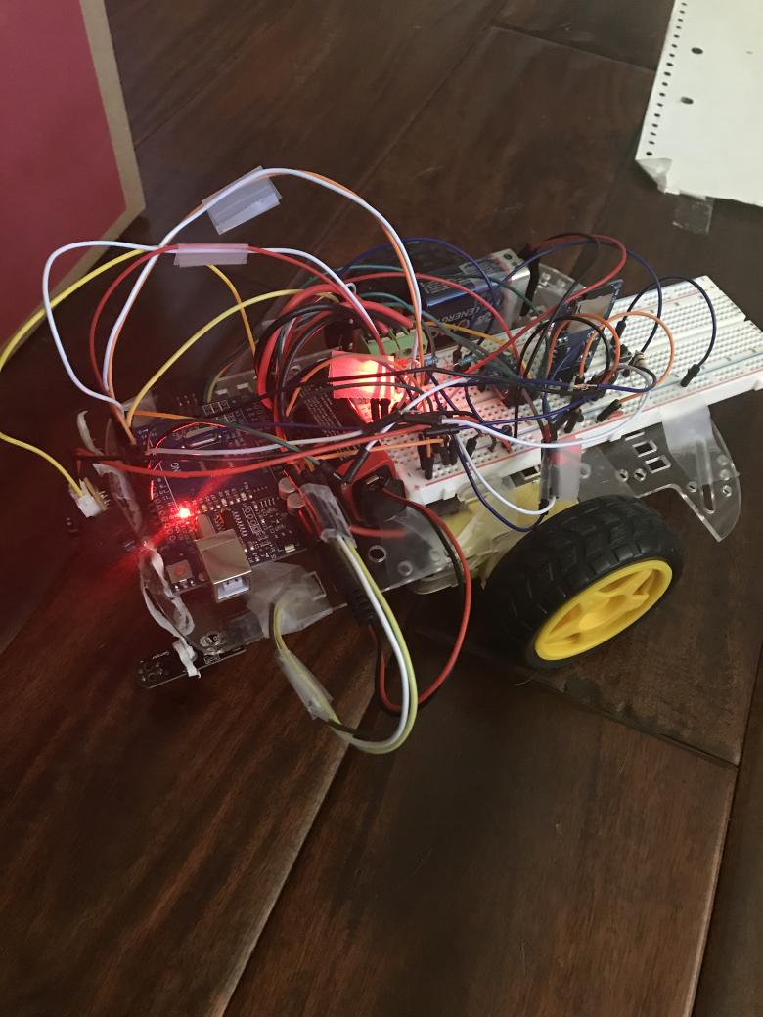
我唔要 D
The Autonomous Car
Final Project
Morning Has Broken 曙光初照
Mt. SAC | ENGR6 | spring 2020
Adrian Marcus Sacks
Pathfinder 探路者
Absalon Soto
Maze Runner 迷宮
Ricky Thang
Trailblazer 拓荒者

Slide 2
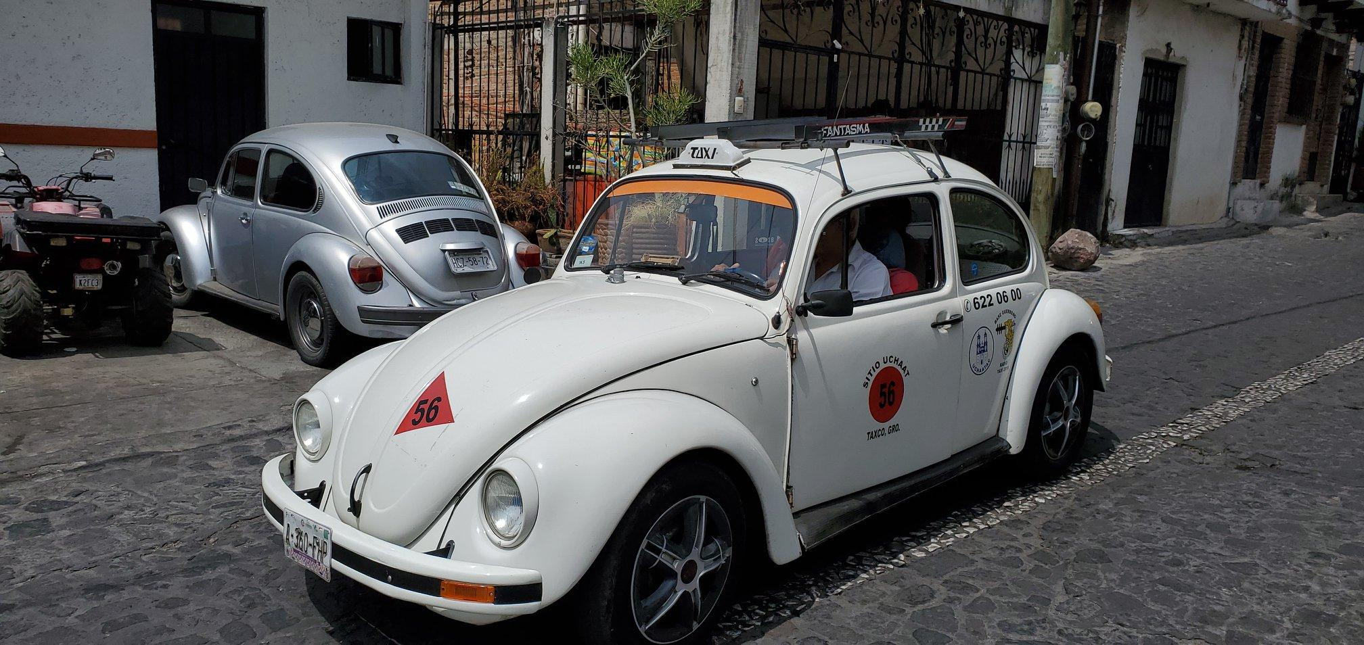
Project Goals
Adrian: follow a path using sensors
Absalon: clear a maze, avoid crashes
Ricky: program a path to be followed
Take it from a Beatle.
Paul McCartney knew it was bad news.
The D in Project D may stand for dream, but when your girl’s a star on the screen, you don’t want to be anywhere in between.
“Baby, you can drive my car”? No way!
Not if my car can drive itself.
This time, Absalon, Adrian, and Ricky are bringing you three iterations on the autonomous vehicle.
No, not this beetle...
我唔要 D

Slide 3
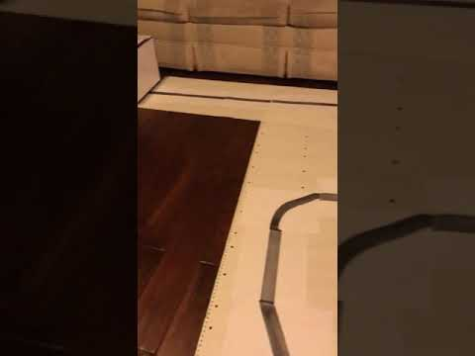
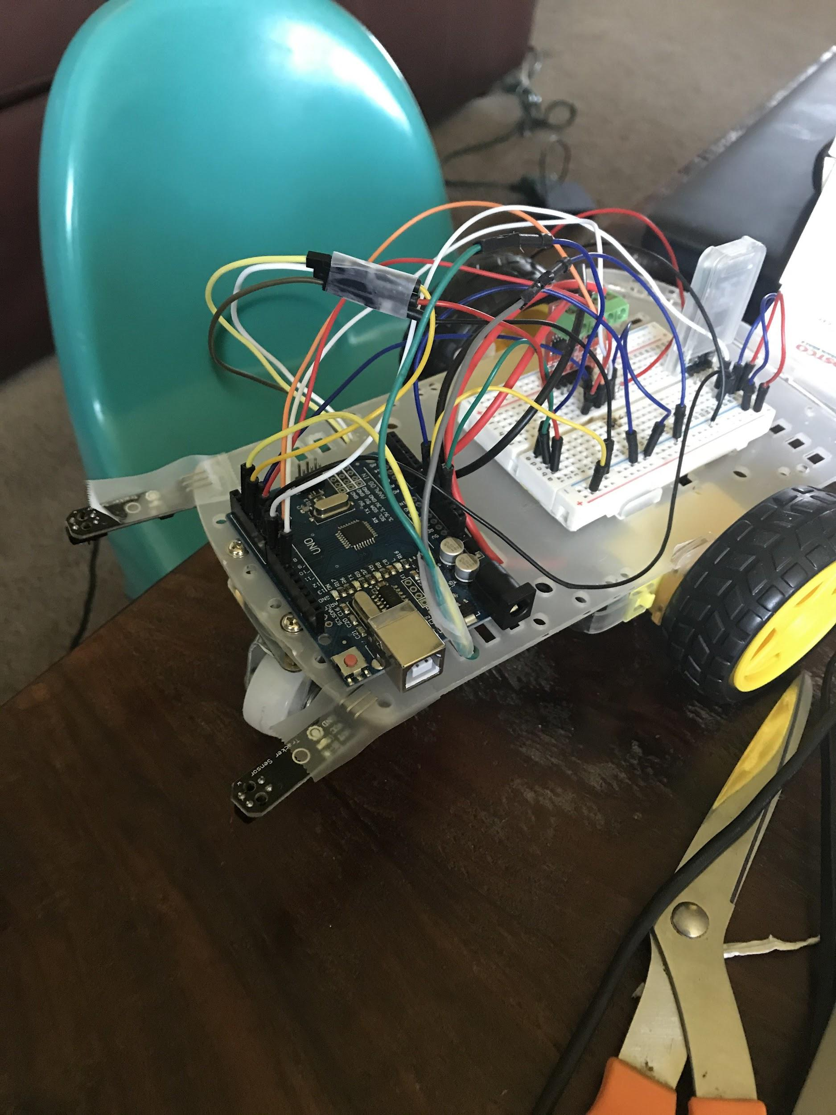
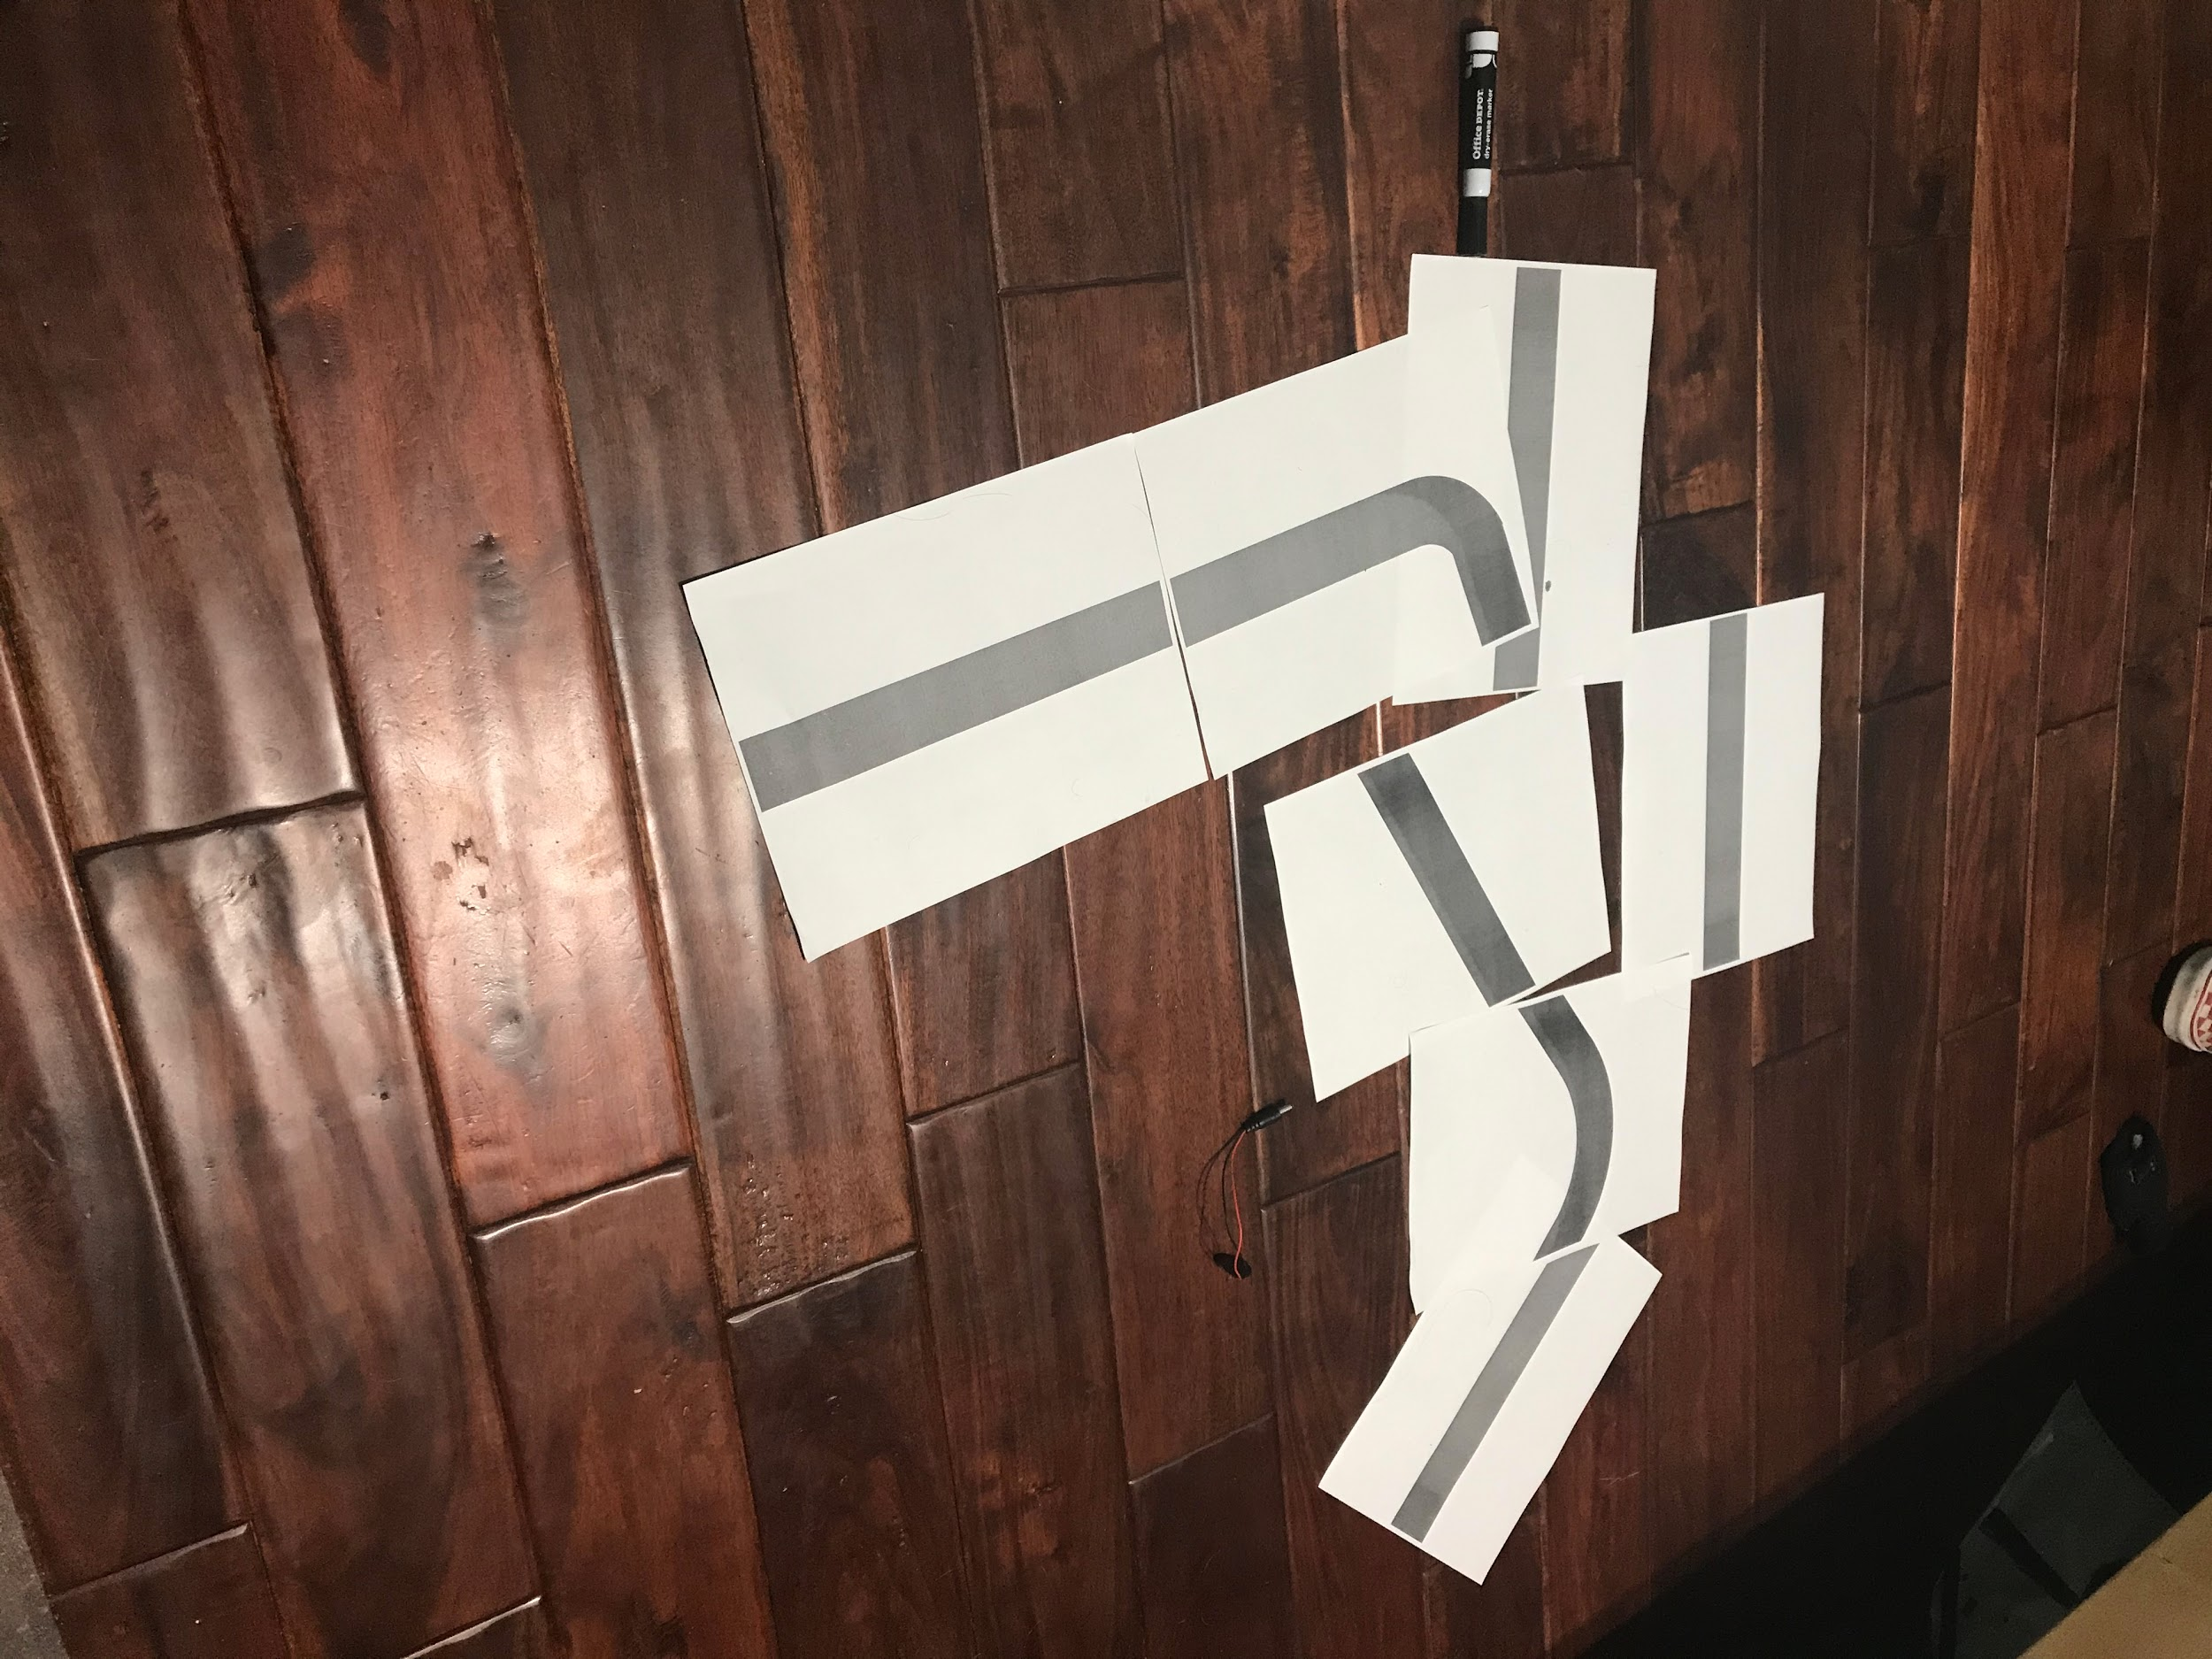
The Pathfinder
The pathfinder uses a tracking sensor to find and follow a colored track on the ground.
Improvements: add voltage dividers to scale speed
我唔要 D

Slide 4
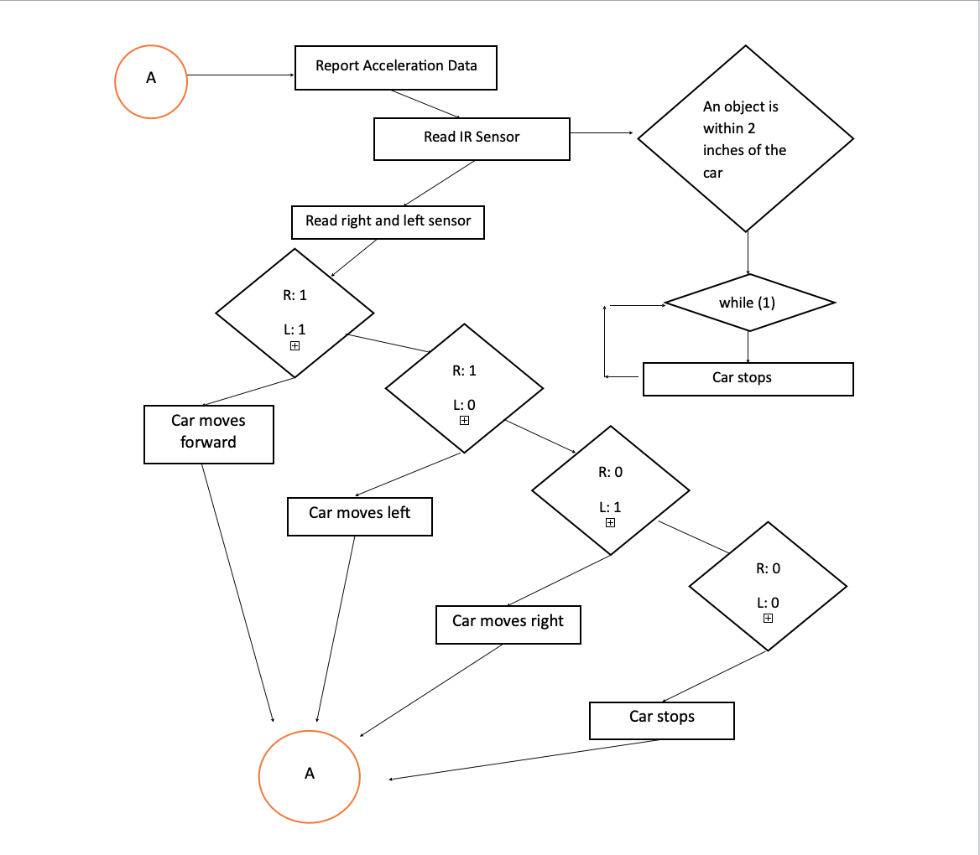

Slide 5
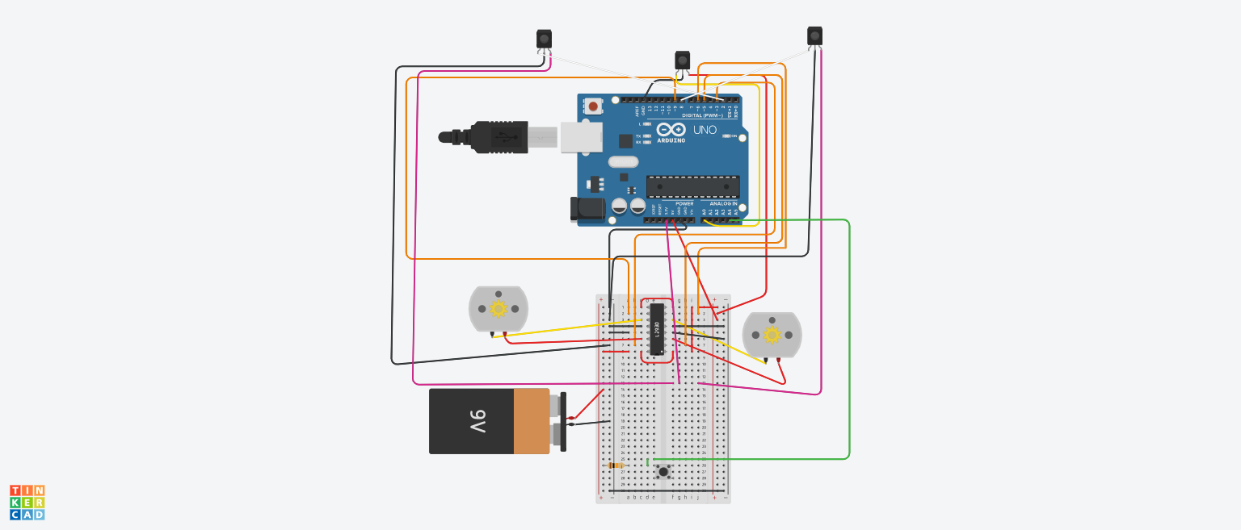

Slide 6
The Maze Runner

Slide 7
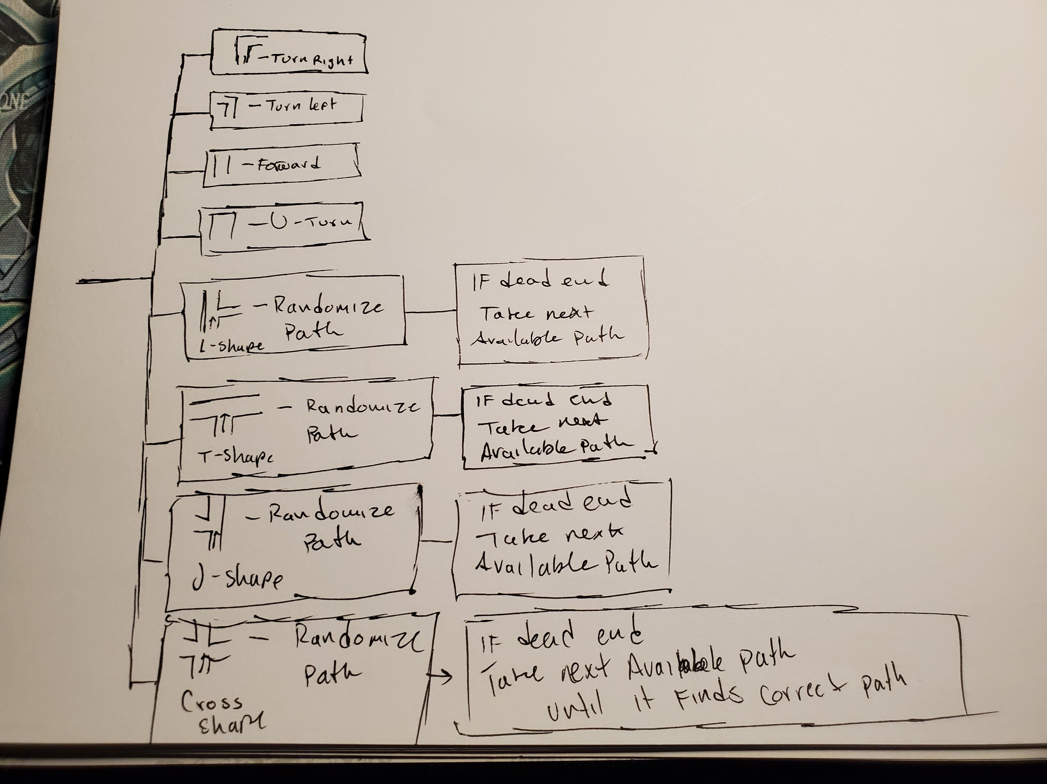
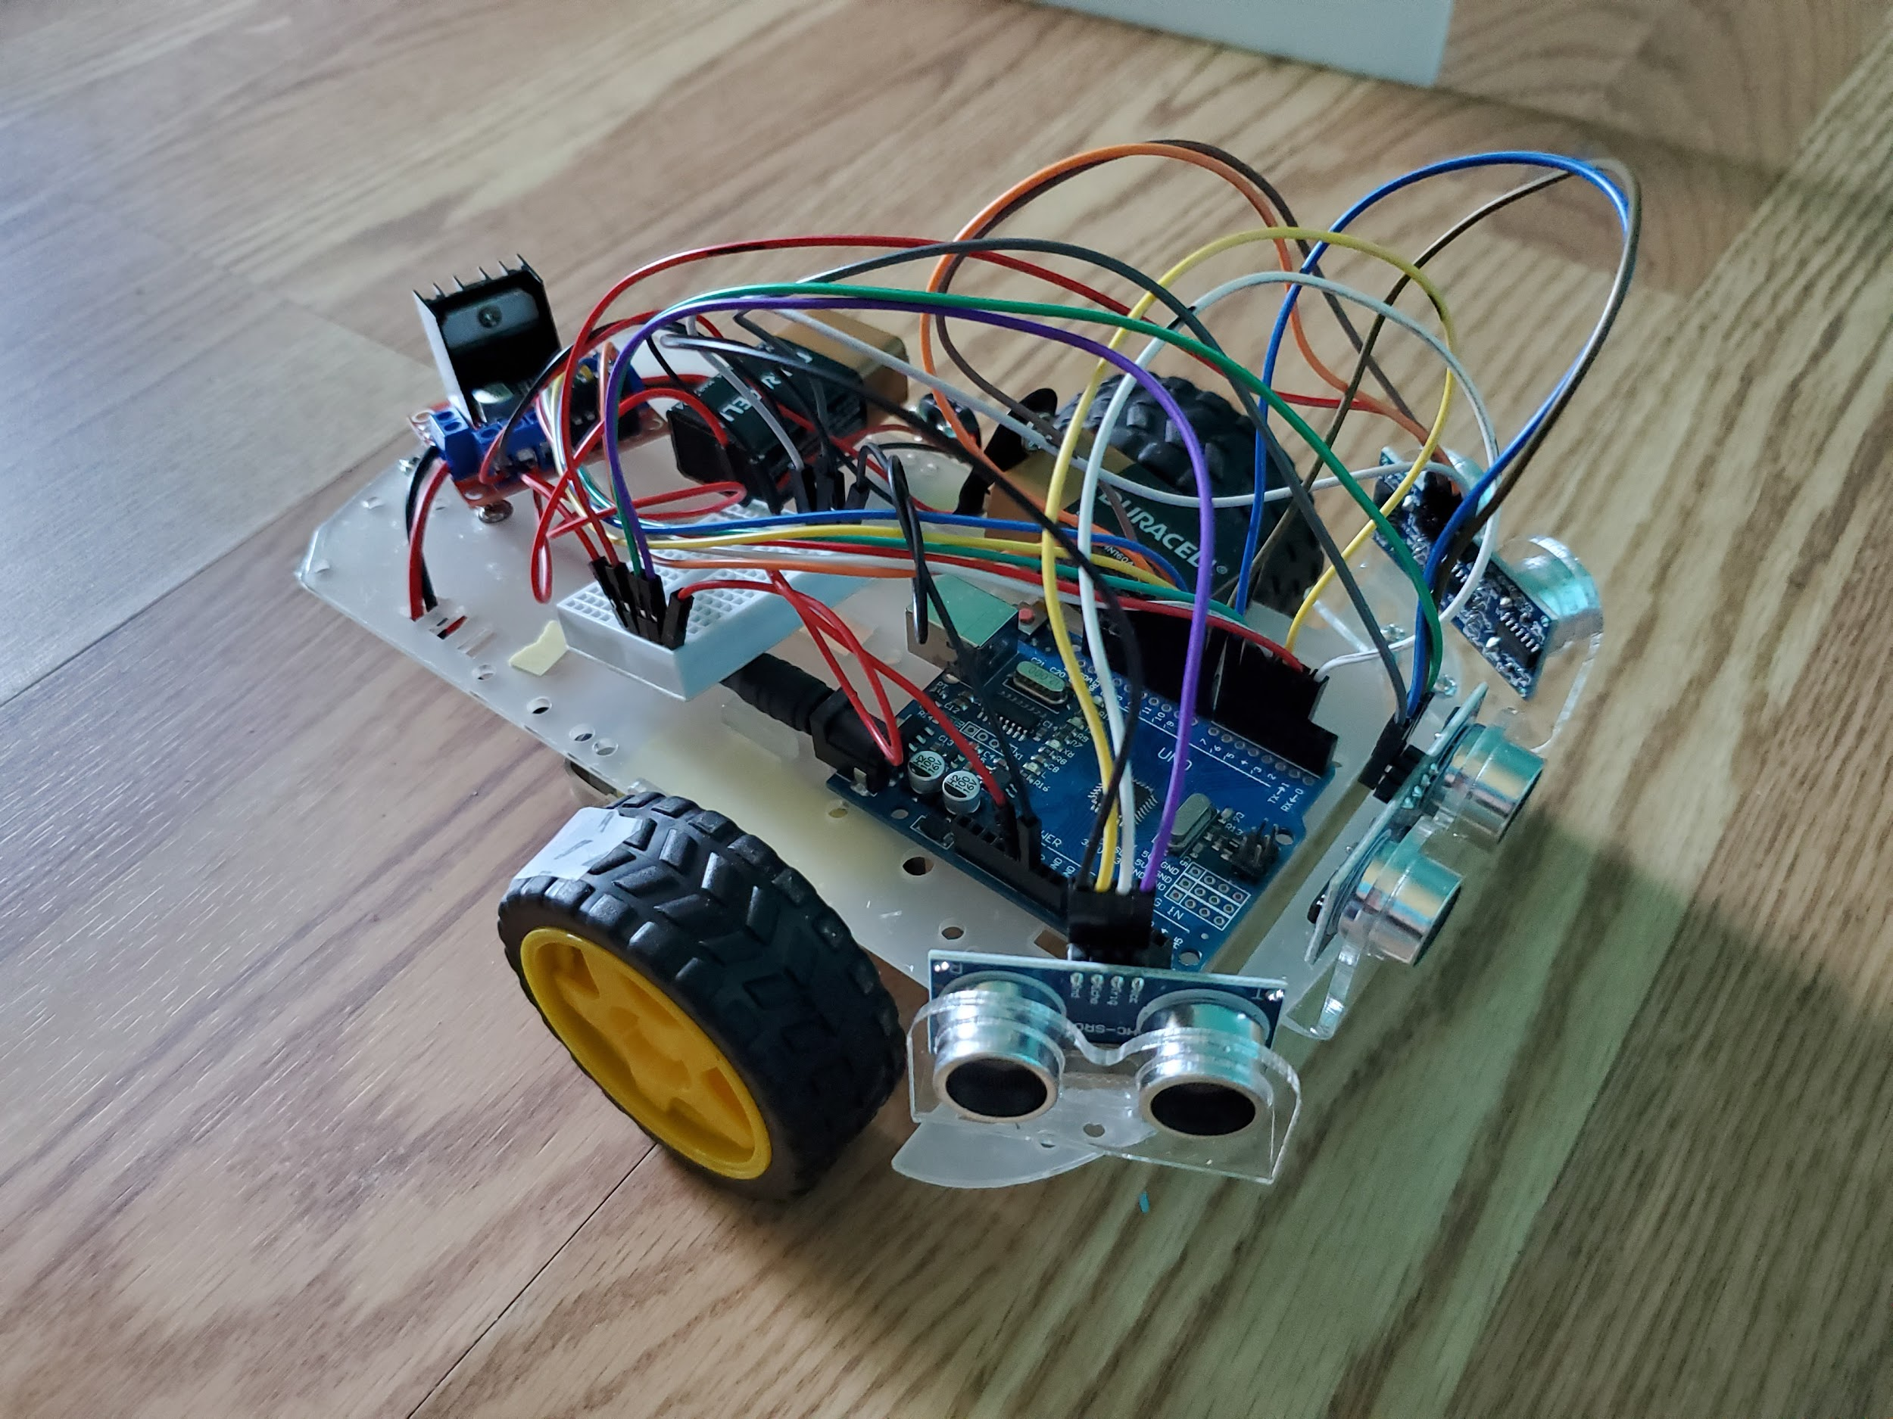

Slide 8
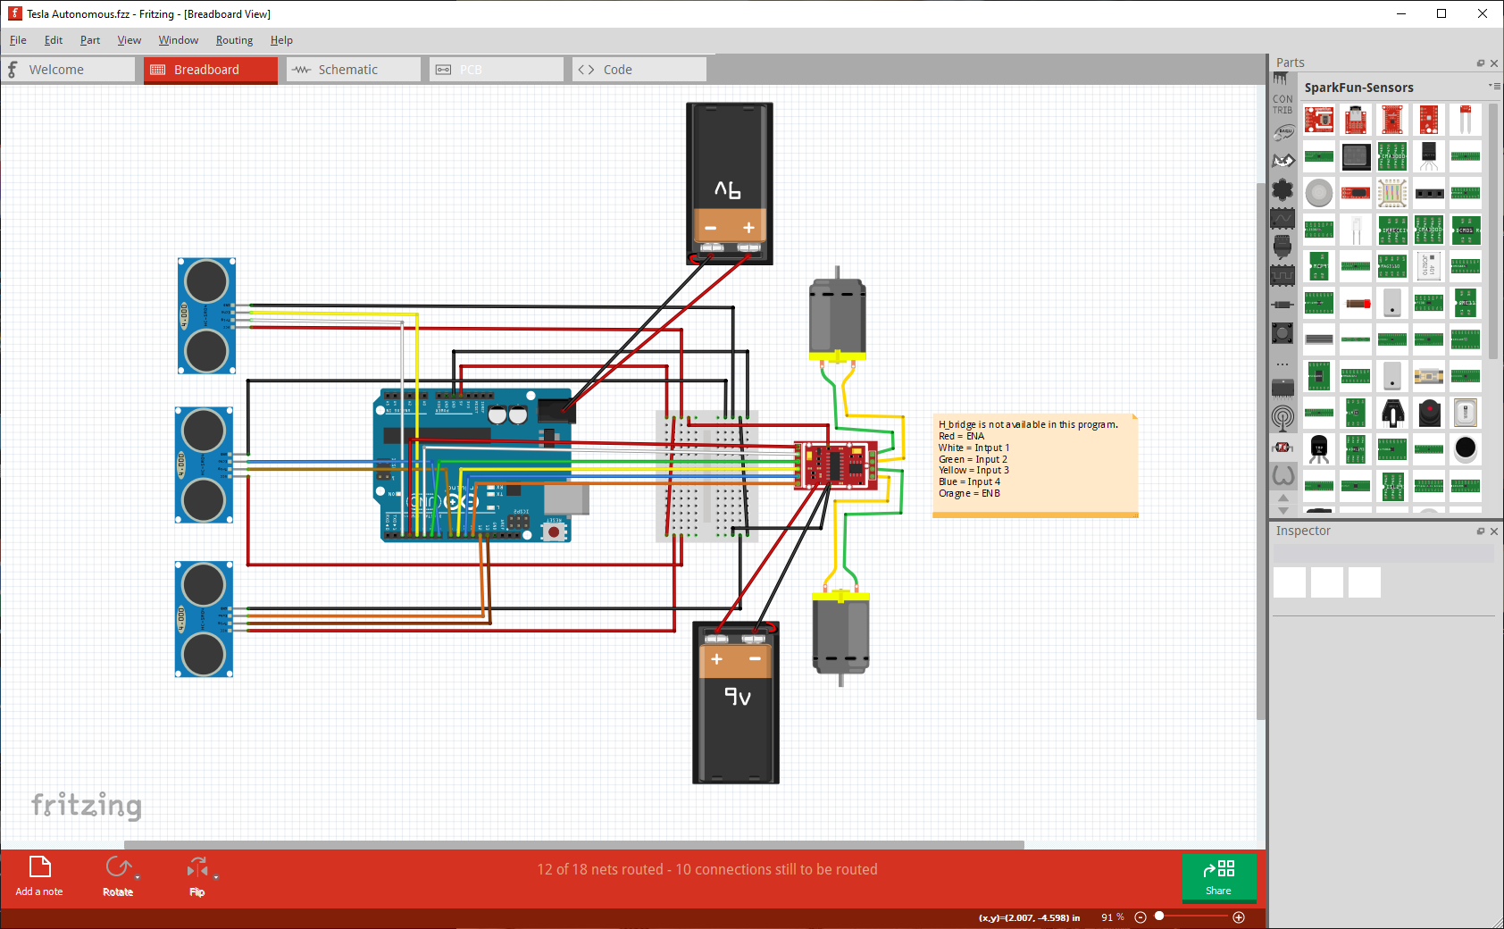

Slide 9
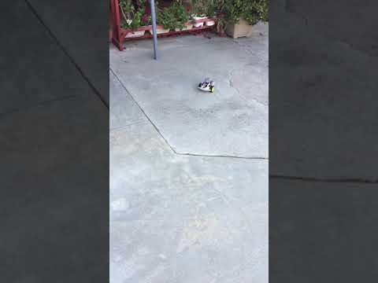
The Trailblazer
Write an array of commands to the EEPROM (e.g. “2 128 10000\n” translates to forward, speed 128, 10,000 milliseconds)
Read EEPROM values and use them as parameters for the car’s motor functions.
我唔要 D
Improvements: connect one more battery, add accelerometer

Slide 10
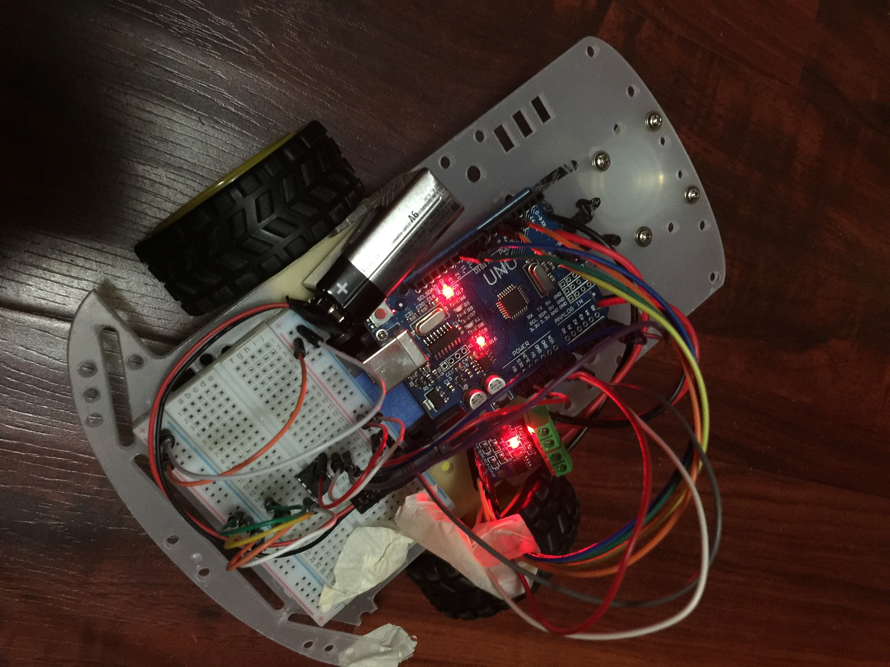
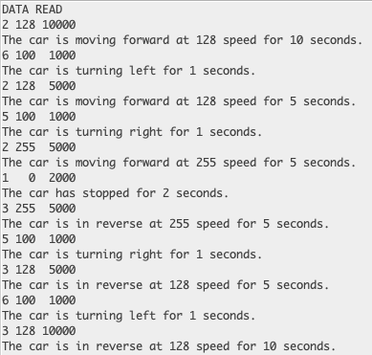
“Tinkercad did not have an EEPROM icon, so here’s a photo of my set-up”
-Ricky
我唔要 D

Slide 11
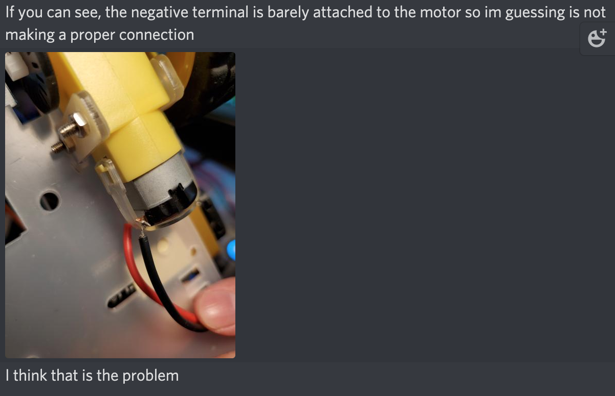
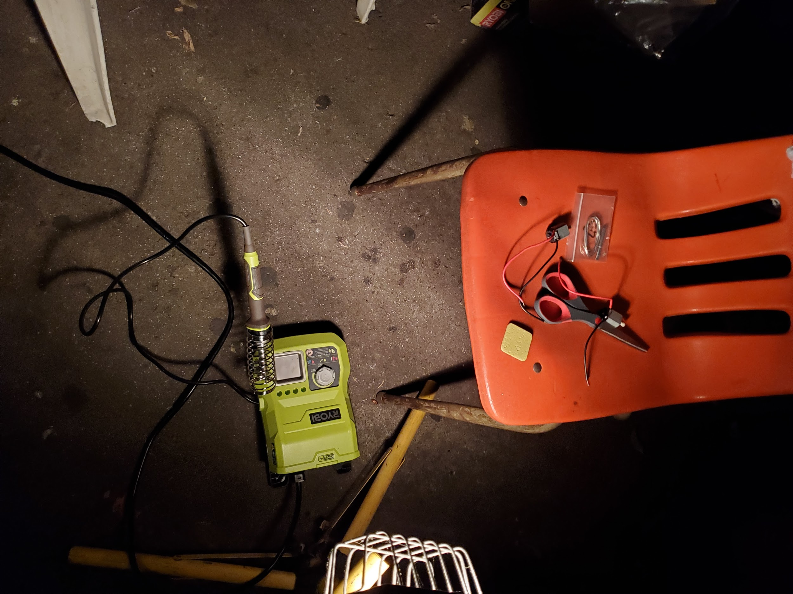
The Team
Collaborative Efforts:
Accelerometer code was meant to be universal, but ended up unused. Absalon did not have enough ports. Ricky did not have an SD card adapter.
Emotional support. (for real)
Code wasn’t copied, but was referenced in designing functions for our respective goals.
Debugged each other’s code.
Some technical difficulties
我唔要 D

Slide 12
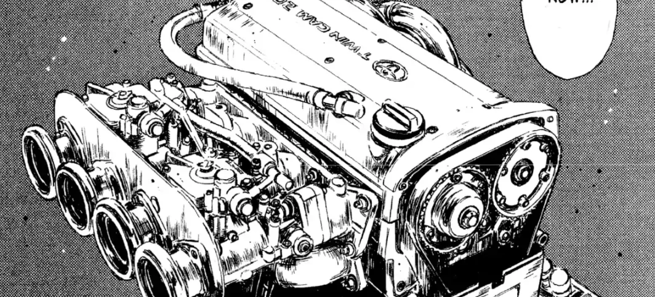
Future Modifications
Add a voltage divider
Background music (e.g. Tokyo Drift, BREAK IN2 THE NITE, Rage your dream)
Improve accelerometer accuracy and calibration
Make precise 90º turns
SD Card Compatibility
我唔要 D

Slide 13
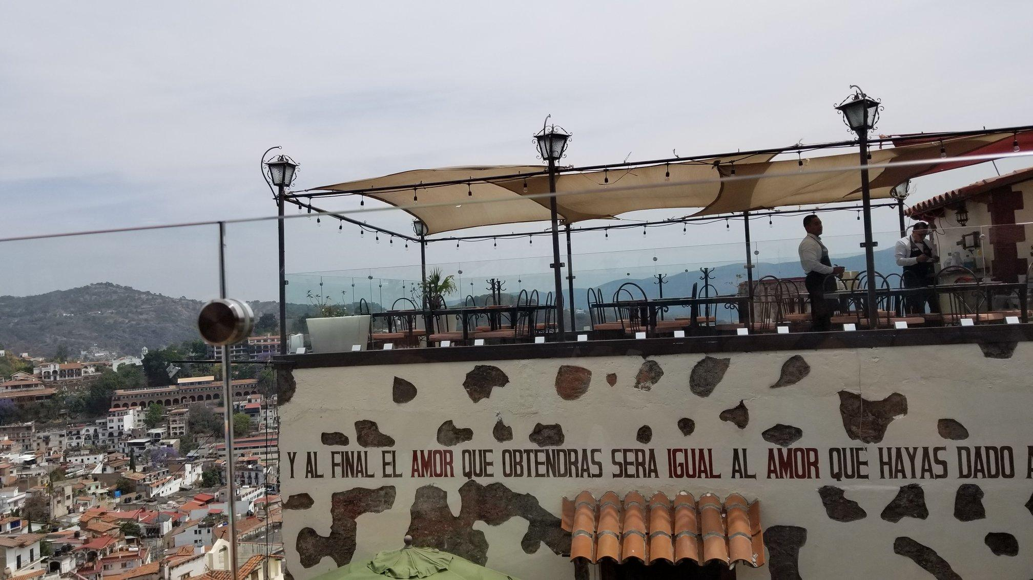
“And in the end, the love you take is equal to the love you make.” -The Beatle

